Slide 1
Security threats and vulnerabilities

Slide 2
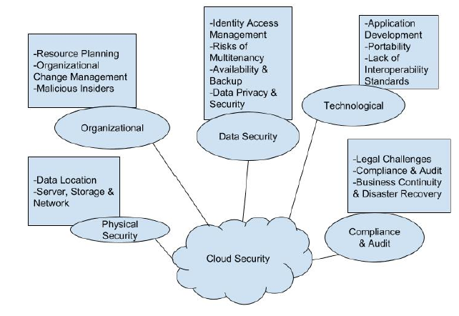
Basic Security Risk Considerations(by CSP And CSC)
Notes:
CSP: cloud service provider
CSC: cloud service consumer

Slide 3
Organizational Security Risks
If a CSP goes out of business or gets acquired by another entity
There could be the threat of malicious insiders in the organization who could do harm using the data provided by their CSCs

Slide 4
Physical Security Risks
The physical location of the cloud data center must be secured by the CSP in order to prevent unauthorized on-site access of CSC data
Even firewalls and encryption cannot protect against the physical theft of data

Slide 5
Technological Security Risks
These risks are the failures associated with the hardware, technologies and services provided by the CSP
In the public cloud, with its multi tenancy features, these include resource sharing isolation problems, and risks related to changing CSPs, i.e. portability. Regular maintenance and audit of infrastructure by CSP is recommended.

Slide 6
Compliance and Audit Risks
These are risks related to the law
That is, risks related to lack of jurisdiction information, changes in jurisdiction, illegal clauses in the contract and ongoing legal disputes
For example, depending on location, some CSPs may be mandated by law to turn over sensitive information if demanded by g

Slide 7
Data Security Risks
The three main properties that we need to ensure are
Data integrity,
Confidentiality
Availability

Slide 8
Data Security Considerations
When the processing and storage of such data is outsourced to infrastructure owned and maintained by a third party, this leads to a host of issues to consider when securing said data
These issues are especially more pronounced in the public cloud, since multiple parties, some of which could be malicious, have to share this aforementioned infrastructure.

Slide 9
Data Security Properties
Privacy
Privacy ensures that the personal information and identity of a CSC are not revealed to unauthorized users
Confidentiality
This is related to data privacy since this is the property ensuring that the data that belongs to a CSC is not revealed to any unauthorized parties.
Integrity
Refers to the confidence that the data stored in the cloud is not altered in any way by unauthorized parties when it's being retrieved
Availability
Ensures that the CSC has access to their data, and are not denied access erroneously or due to malicious attacks by any entity

Slide 10
Data Stages
Data-in-transit
This is when data is in the process of being transmitted either to the cloud infrastructure or to the computing device used by the CSC. Encryption is generally used here
Data-at-rest
This is when data has been stored in the cloud infrastructure. The main issue with this stage for the CSC is their loss of control over the data
Data-in-use
This is when data is being processed into information. Here, the issues might lie with the corruption of data while it is being processed

Slide 11
Methods to ensure Data security
Authentication in the Cloud
Authentication for the CPC can be done either by the CSP or outsourced to third party specialists examples
Encryption techniques in the cloud
Caesar Cipher
S-DES
RSA
Secure Socket Layer

Slide 12
Caesar Cipher
It is a classical substitution cipher. A simple example of such a cipher replaces the letter of alphabet with a letter that is 3 paces ahead of it, for example "ZULU" will be converted into "CXOX".
There are only 25 possible key options and as such this cipher can easily be brute forced

Slide 13
S-DES
Simplified Data Encryption Standard has a process of key generation where instead of using a key as is for encryption and decryption, the key generation process of S-DES generates 2 sub keys after processing the initial 10 bit input
It is not quite as widely used anymore since computing power has caught up with breaking it.

Slide 14
RSA (Ron Rivest, Adi Shamir, Leonard Adleman)
A cryptographic algorithm whose encryption key is public and differs from the decryption key which is kept secret
It is one of the more commonly used encryption algorithms nowadays

Slide 15
Secure Socket Layer (SSL)
128 bit encryption
it is a commonly-used protocol for managing the security of a message transmission on the Internet and it uses public and private key encryption system

Slide 16
References
http://www.cse.wustl.edu/~jain/cse570-15/index.html
https://www.datapine.com/blog/cloud-computing-risks-and-challenges/

